Slide 1

RFID BASED ATTENDANCE SYSTEM
Submitted by:
Vasu Gamdha (17IT027)
Maulik Gevariya (17IT029)
Dirgh Jani (17IT035)

Slide 2
contents
Project overview
Main Technology-RFID
Hardware Requirements
Software Requirements
Working of the project
Advantages
Applications
Limitation
Future scope
Conclusion

Slide 3
Project overview
The main functionality of this project is to verify the identity / attendance of the user who needs to access it through RFID.
For this purpose the authorized person is given an RFID card.
This card contains an integrated circuit that is used for storing, processing information through modulating and demodulating of the radio frequency signal that is being transmitted.
Thus, the data stored in this card is referred as the identification/attendance of the person.
Once, the person places the card in front of the RFID card reader, it reads the data and verifies it with that data present in the Cloud Storage and if it matches then LED is blinked as valid entry and the student attendance is marked Present.

Slide 4
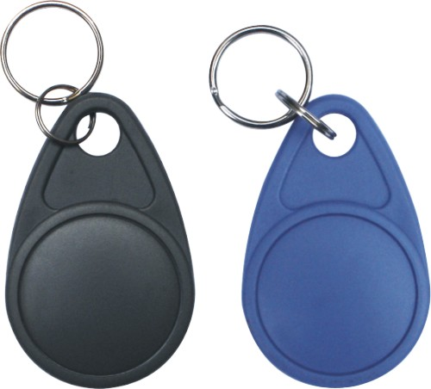
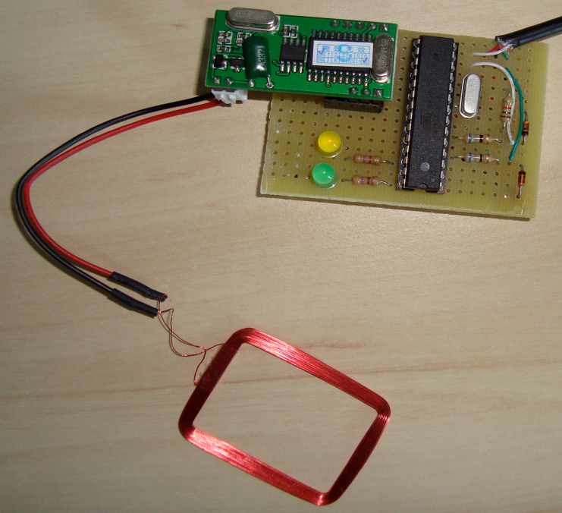
Radio frequency identification(RFID)
RFID Benefits and Scanning
Eliminates human error
Improves speed and efficiency
Increases information availability and location
Allows enhanced security
Delivers data with or without network connection
Applications of RFID
Security And Access Control
Parking Management
Library Management
Asset Tracking
Healthcare

Slide 5
HARDWARE REQUIREMENTS
NodeMCU (Wi-Fi Module)(ESP8266)
RFID KIT
RFID Cards and tags
RFID Receiver(RC522)
PCB Board
Light Emitting Diode(LED)
Sound Buzzer
Jumper Wire
USB Cable

Slide 6
Software requirements
Programming of Node MCU: ARDUINO(IDE)
Database: Firebase
Application Development software: MIT App Inventor 2

Slide 7
Working of project
The project uses a RFID reader that sends a 13.56 MHz signals when a RFID card is scanned over the RFID Reader.
When the card is scanned and if the unique ID matched with our Database, The White LED blinks along with a sound buzzer. And if it Don’t Matches, Then The Red LED blinks.
The Attendance is marked present If and only if White LED blinks.
The data then is updated with the date and time of scanning the card and the attendance is Marked Present for that Session.
When required, the Status of the Attendance can be accessed by the Student as well as Administrator through the Application Developed for this purpose.

Slide 8
ADVANTAGE
Proxy Attendance Can Be Reduced.
Hard Copy Paper Work for Attendance Sheet Can Be Reduced.
Data can be Stored For Long Time Compare to Attendance Sheet.
Human Error can be removed as it is automated System.
Time Can be saved.
The Attendance can be viewed easily by Administrator on Mobile phone.

Slide 9
Application
RFID based attendance system can be used in educational institutes, industries, everywhere.
RFID is Emerging Technology and can be used in application where authentication is needed.

Slide 10
Limitations
RFID system is secured but it can also be misused sometimes. A Person can gives Another Person’s attendance if he/she has access to card.
It is a machine based Application, So power supply is Mandatory. If there is no power supply, we need to use another manual mean of attendance.

Slide 11
Future Scope
Range of RFID can be increased so reader detect the card from far distance.
The transferred data can be stored in PC to keep record through a specific software.
Timely attendance can be monitored. i.e. time in and time out can be recorded using real time clock and can be stored in database.
Further, Fingerprint Scanner or Face Recognizer can also be used to get Two-Step Verification to avoid misuse of RFID card.
We can implement GSM(Message) technology.

Slide 12


Slide 13


